Slide 1
Strings in Detail

Slide 2
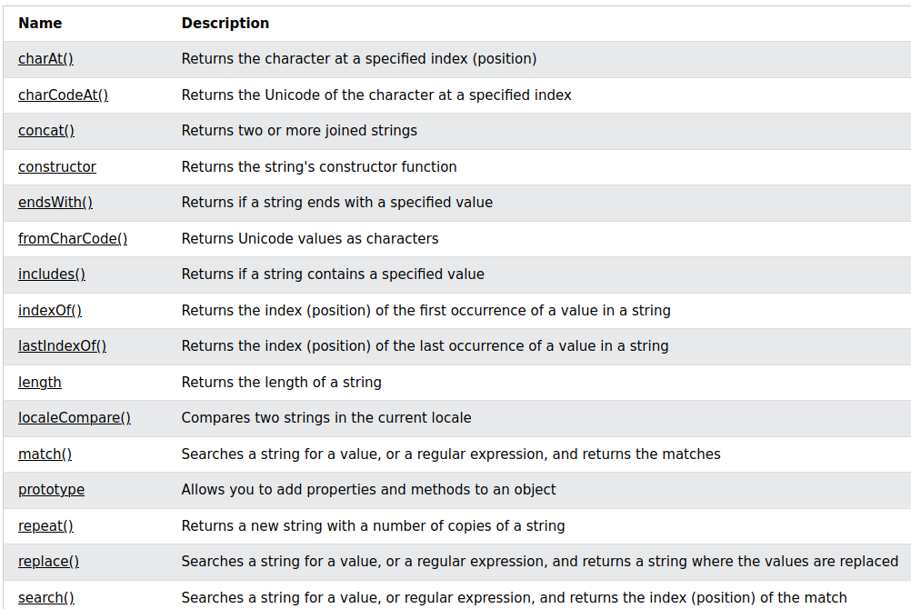
Ref: https://www.w3schools.com/jsref/jsref_obj_string.asp

